Slide 1
Week 3
An Introduction to Cyber Security – CS 573
Instructor: Dr. Edward G. Amoroso
eamoroso@tag-cyber.com

Slide 2
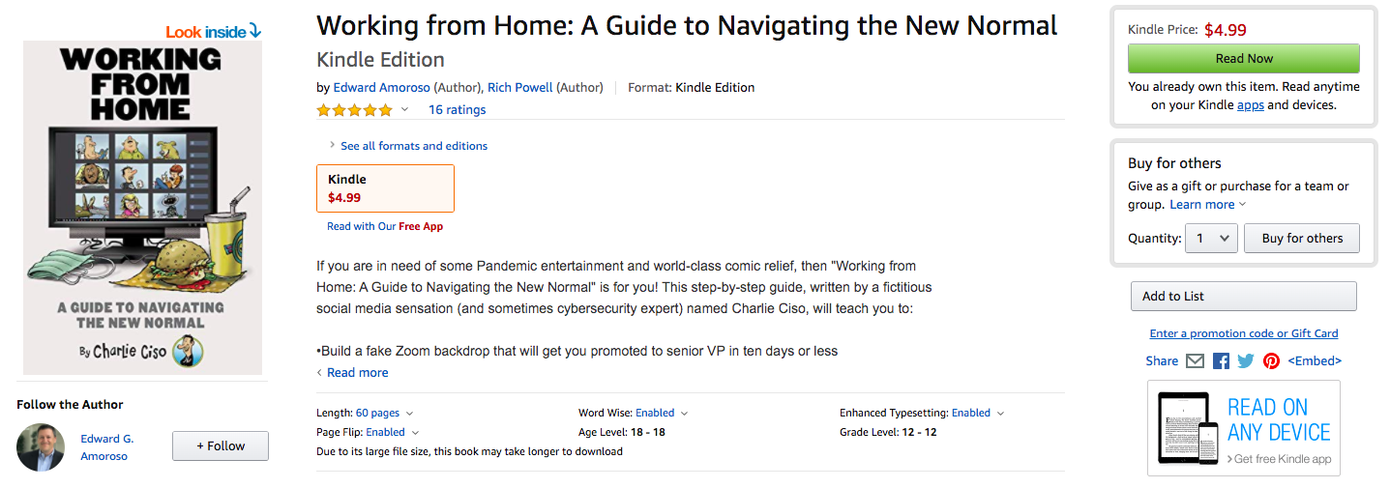
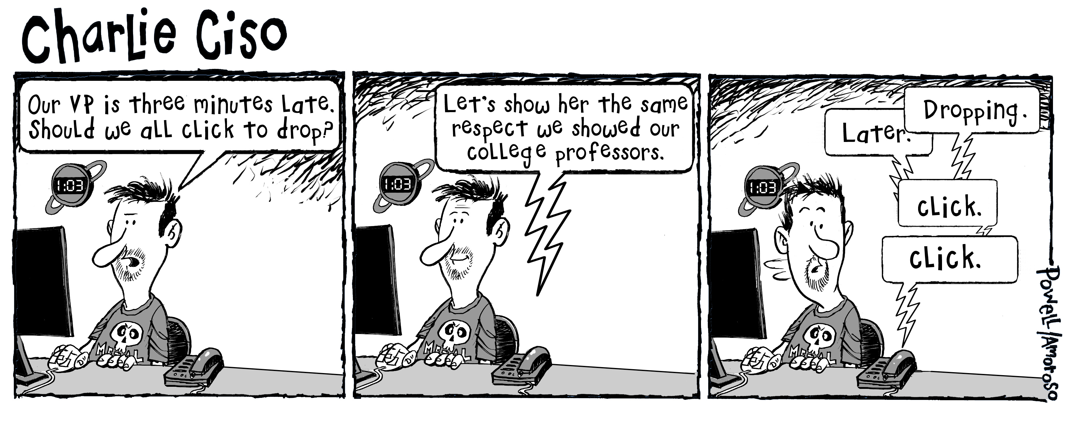
Week 3

Slide 3
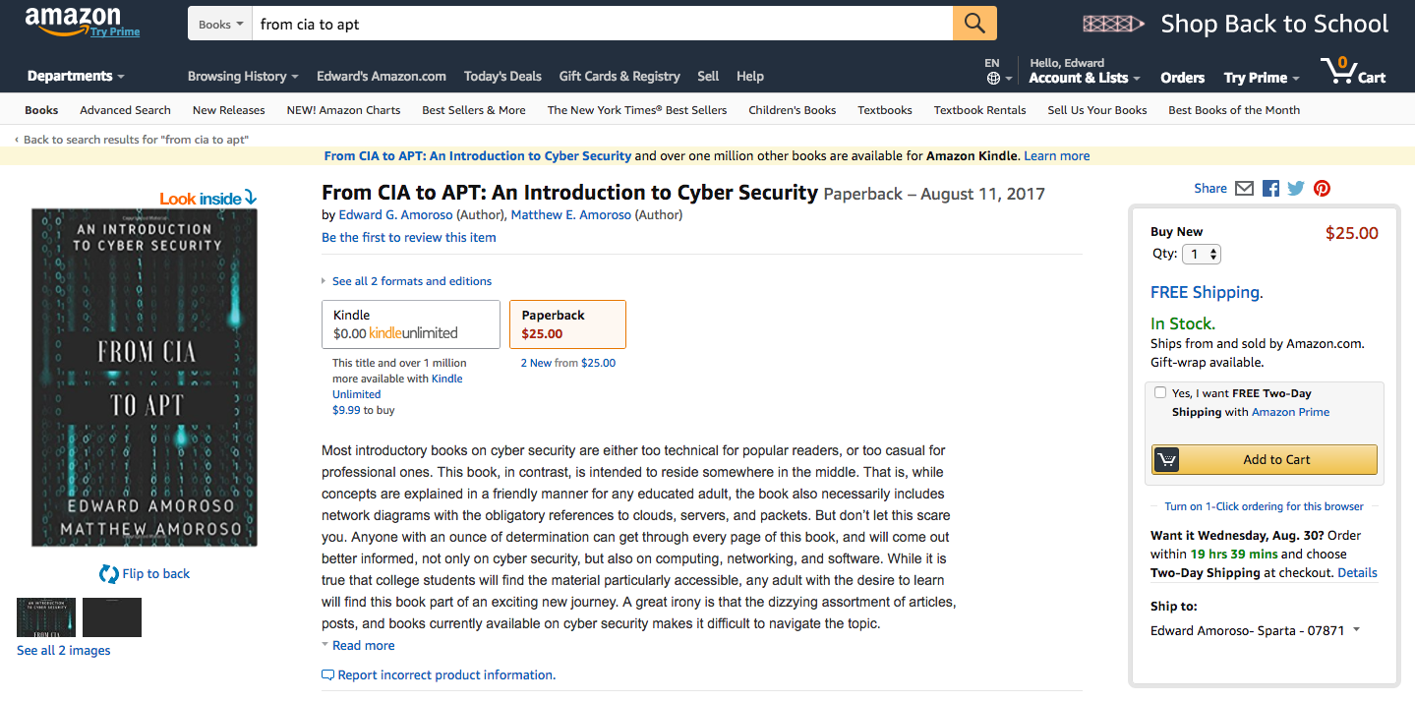
Required Text – $9.99 Download from Amazon.com
$25.00 Printed Paperback Book from Amazon.com
From CIA to APT: An Introduction to Cyber Security
Edward G. Amoroso & Matthew E. Amoroso
Week 3

Slide 4
Week 3
Required Week Three Readings:
1. “The Birth and Death of the Orange Book,” Steve Lipner
https://www.stevelipner.org/links/resources/
The%20Birth%20and%20Death%20of%20the%20Orange%20Book.pdf
2. Chapters 8 through 11: From CIA to APT: An Introduction
to Cyber Security, E. Amoroso & M. Amoroso

Slide 5



Week 3: Network Security Threats
Week 3
High Tide
Low Tide

Slide 6
Week 3
Real Time Network Security Behavioral Analytics
What You See
Metric
Time

Slide 7
Week 3
Real Time Network Security Behavioral Analytics
What You See
What You Expect
Metric
Time

Slide 8
Week 3
Real Time Network Security Behavioral Analytics
Sound
Alarm Here
What You See
Alarm Threshold Distance
What You Expect
Metric
Time

Slide 9
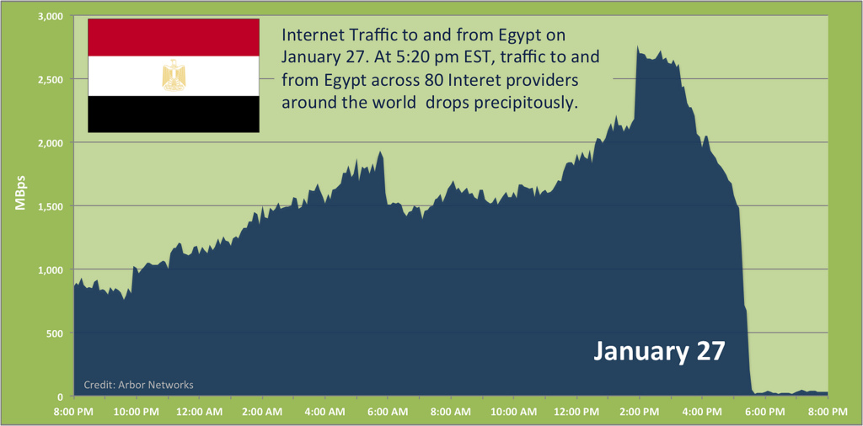
Week 3
Internet Blackout in Egypt – 01/27/11
Sound
Alarm Here

Slide 10
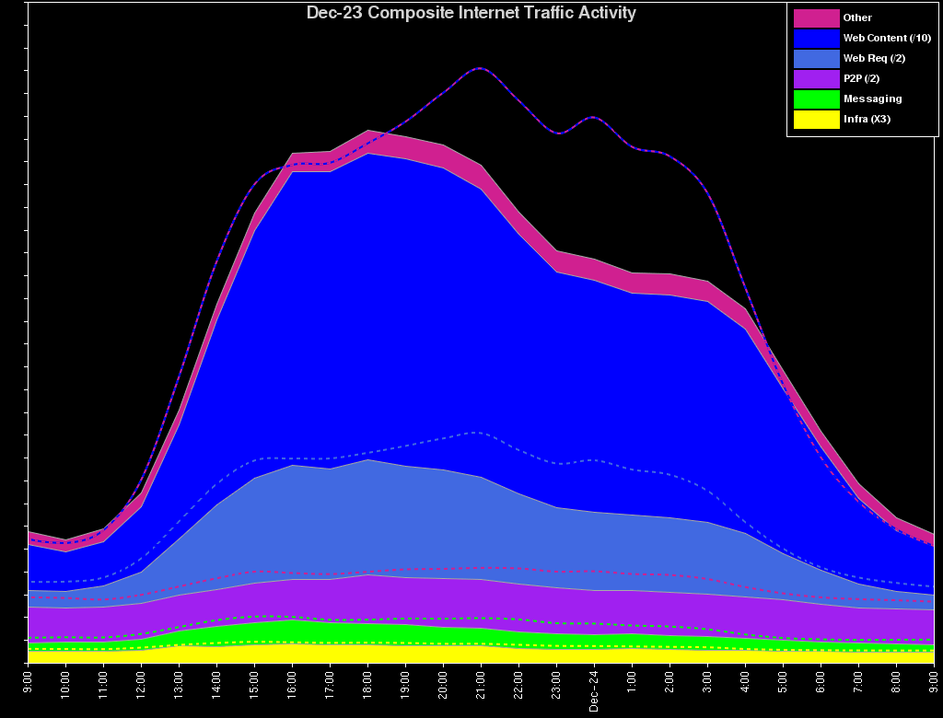
Generic View of Public Internet Traffic – 12/23/04
Week 3
Expected Profile
Observed Actual

Slide 11
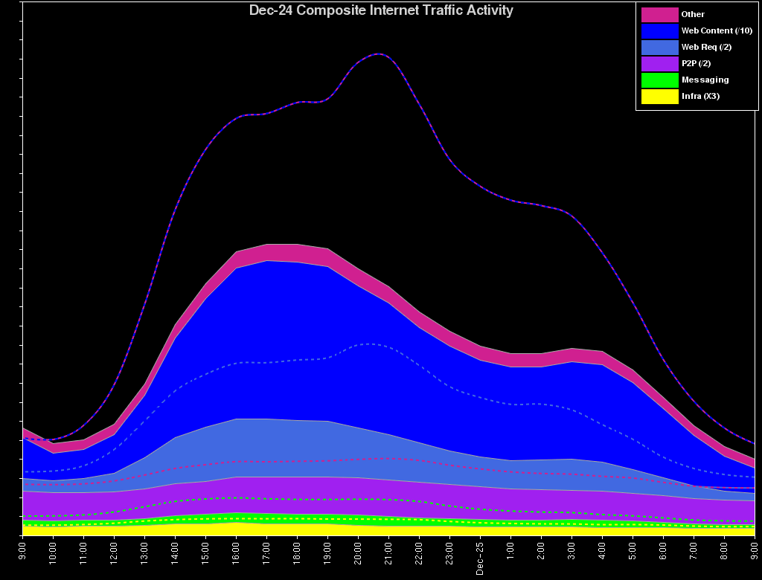
Generic View of Public Internet Traffic – 12/24/04
Week 3
Expected Profile
Observed Actual

Slide 12
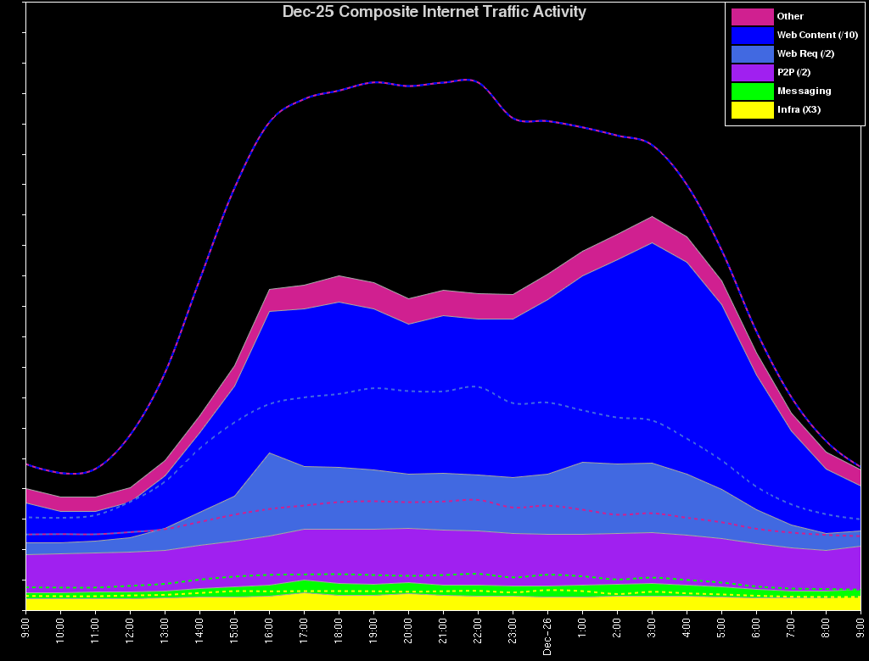
Generic View of Public Internet Traffic – 12/25/04
Week 3
Expected Profile
Observed Actual

Slide 13
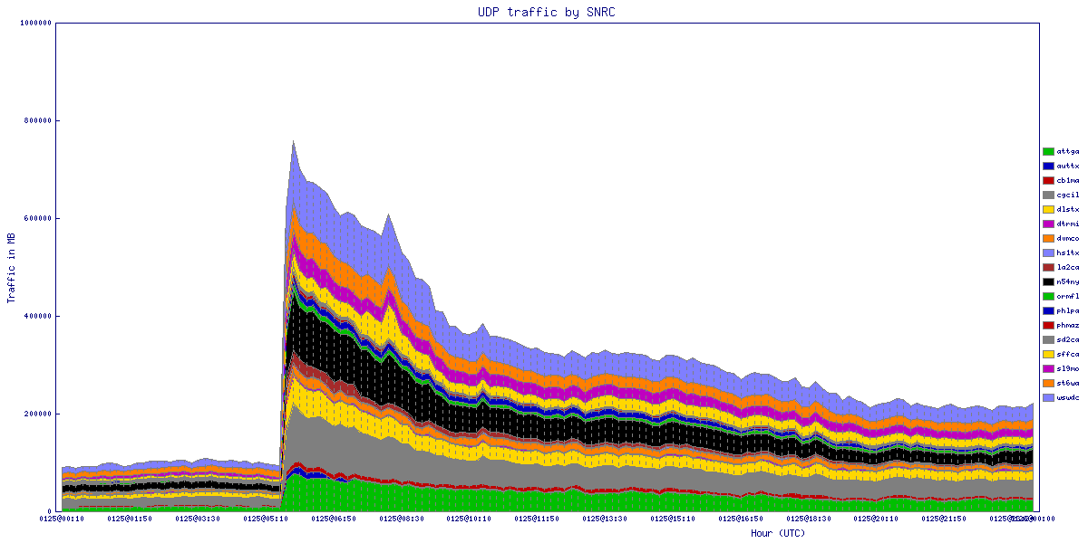
Internet View of Slammer Worm – UDP Port 1434: 01/25/03
Week 3
Start of Slammer Worm
(UDP Port 1434)

Slide 14
Week 3
Internet View of Slammer Worm – 01/03/03 – 01/25/03

Slide 15
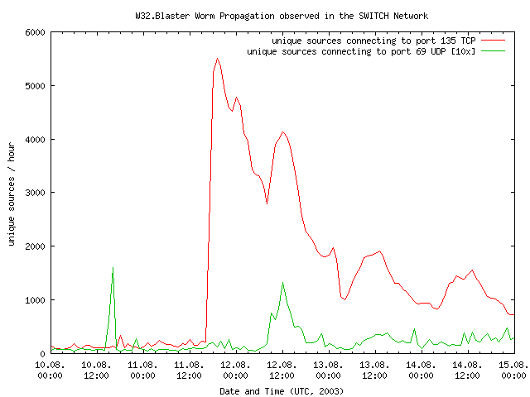
Sharp Spike from Blaster Worm – 8/11/03
Week 3

Slide 16
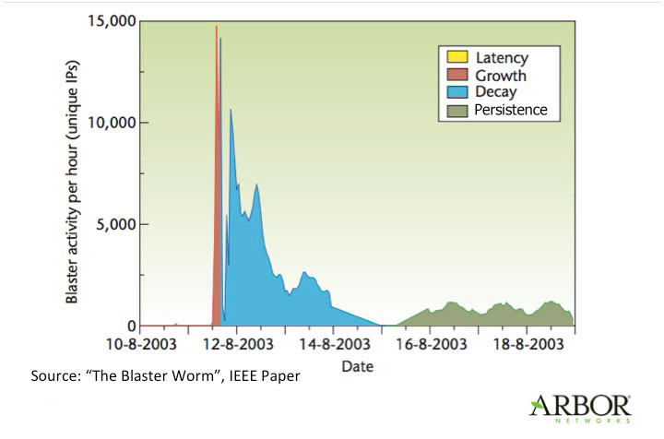
Sharp Spike from Blaster Worm – 8/11/03
Week 3

Slide 17
Internet View of TCP 135 – Blaster Worm – 2003
Week 3

Slide 18
Deeper Internet View of TCP 135 Activity – Blaster Worm
Week 3

Slide 19
Nachi Worm of 2003
Week 3
Flows
First Evidence of
Worm Detected
by Global ISPs
(8/17/03)
Evidence of
Worm Ramping
Up and Up
(8/18 – 8/19)
High
Normal Pattern of
Use for ICMP 8 Traffic
Medium
Low
08/17/03
12:00PM
08/18/03
12:00AM
08/18/03
12:00PM
08/19/03
12:00AM
08/19/03
12:00PM

Slide 20
Nachi 8/17/03 10:00PM
Week 3

Slide 21
Nachi 8/17/03 11:00PM
Week 3
Watch Here . . .

Slide 22
Nachi 8/17/03 Midnight
Week 3

Slide 23
Nachi 8/18/03 1:00AM
Week 3

Slide 24
Nachi 8/18/03 2:00AM
Week 3

Slide 25
Nachi 8/18/03 3:00AM
Week 3

Slide 26
Nachi 8/18/03 4:00AM
Week 3

Slide 27
Nachi 8/18/03 5:00AM
Week 3

Slide 28
Nachi 8/18/03 6:00AM
Week 3

Slide 29
Nachi Worm (08/03 – 01/04)
Week 3

Slide 30
Spoofing and Reflection
Week 3
Typically just change
source IP address to Bob
Dupe
(Internet User)
Spoofing
1. Alice asks Dupe
a question as Bob
Alice
(Malicious Actor)
Bob
(Web Server)

Slide 31
Spoofing and Reflection
Week 3
Typically just change
source IP address to Bob
Destination IP address
set to Bob’s IP address
Dupe
(Internet User)
Spoofing
Reflection
1. Alice asks Dupe
a question as Bob
2. Dupe sends
response to Bob
Alice
(Malicious Actor)
Bob
(Web Server)

Slide 32
Distribution and Amplification
Week 3
Botnet
1. Alice infects group
of computers (botnet)
2. Alice can command
botnet to attack Bob
Alice
(Malicious Actor)
Bob
(Web Server)

Slide 33
Distribution and Amplification
Week 3
Amplifying Service
3. Botnet targets service
that amplifies responses
(e.g., DNS)
Botnet
1. Alice infects group
of computers (botnet)
2. Alice can command
botnet to attack Bob
Alice
(Malicious Actor)
Bob
(Web Server)

Slide 34
Distribution and Amplification
Week 3
Amplifying Service
3. Botnet targets service
that amplifies responses
(e.g., DNS)
Botnet
1. Alice infects group
of computers (botnet)
2. Alice can command
botnet to attack Bob
DDOS Attack
4. Bots ask amplifying
service a “small” question
spoofed as Bob
5. Results are “large, amplified”
responses to Bob (DDOS Attack)
Alice
(Malicious Actor)
Bob
(Web Server)

Slide 35
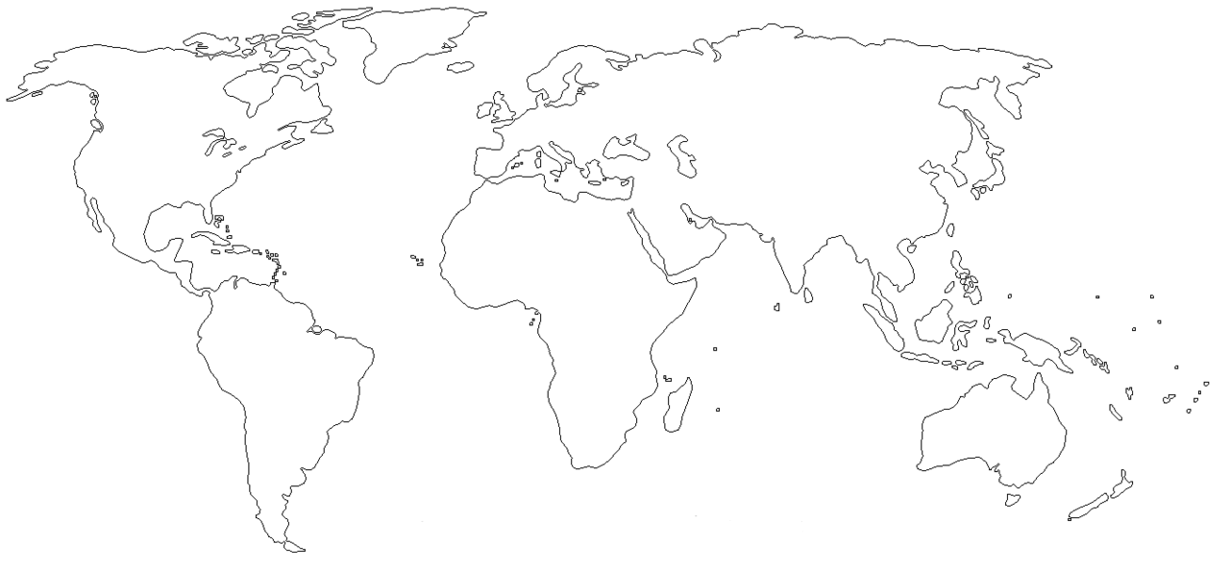
Botnets
Week 3
Bots
Bots
Botnet Command
and Control (C&C)
Robust, Secure
Communication
with Multiple C&C
Botnet Software
Drop Locations

Slide 36
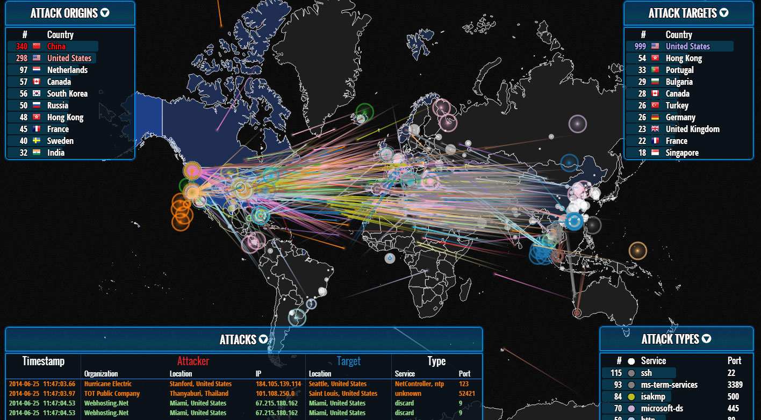
Typical Botnet Visualization
Week 3

Slide 37
Bot Capacity Generation (500Kbps)
Week 3
65K
.
.
30K
25K
Assumed 0.5 Mbps
Outbound Single Bot
Capacity Generation
20K
15K
10K
5K
3
T1
(1.5 Mbps)

Slide 38
Bot Capacity Generation (500Kbps)
Week 3
65K
.
.
30K
25K
Assumed 0.5 Mbps
Outbound Single Bot
Capacity Generation
20K
15K
10K
5K
3
129
T1
(1.5 Mbps)
OC3
(155 Mbps)

Slide 39
Bot Capacity Generation (500Kbps)
Week 3
65K
.
.
30K
25K
Assumed 0.5 Mbps
Outbound Single Bot
Capacity Generation
20K
15K
10K
5K
4,147
3
129
T1
(1.5 Mbps)
OC3
(155 Mbps)
OC48
(2.4 Gbps)

Slide 40
Bot Capacity Generation (500Kbps)
Week 3
65K
.
.
30K
25K
Assumed 0.5 Mbps
Outbound Single Bot
Capacity Generation
20K
16,667
15K
10K
5K
4,147
3
129
T1
(1.5 Mbps)
OC3
(155 Mbps)
OC48
(2.4 Gbps)
OC192
(10 Gbps)

Slide 41
Bot Capacity Generation (500Kbps)
Week 3
65K
66,668
.
.
30K
25K
Assumed 0.5 Mbps
Outbound Single Bot
Capacity Generation
20K
16,667
15K
10K
5K
4,147
3
129
T1
(1.5 Mbps)
OC3
(155 Mbps)
OC48
(2.4 Gbps)
OC192
(10 Gbps)
OC786
(40 Gbps)

Slide 42
Botnet Capacity Generation (750 Kbps – 1.0 Mbps)
Week 3
Number of Bots
Outbound Capacity
Size of Attack
Network Size
2
750 Kbps
1.5 Mbps
T1
1,200
1.0 Mbps
1.2 Gbps
OC-24
2,400
1.0 Mbps
2.4 Gbps
OC-48
10,000
1.0 Mbps
10.0 Gbps
OC-192
40,000
1.0 Mbps
40.0 Gbps
OC-768
80,000
1.0 Mbps
80.0 Gbps
Starts to fill
typical ISP
backbone
100,000
1.0 Mbps
100 Gbps
1,000,000
1.0 Mbps
1000 Gbps

Slide 43
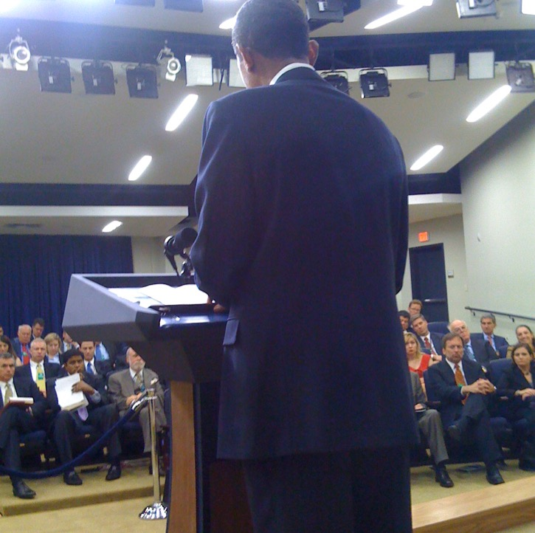
Week 3

Slide 44
Case Study: Mitigating Inbound Election Reporting DDOS
Week 3
LAN/ISP
ISP
LAN
Regional Election
Management System
Election Results
Reporting Server
Reports Working
Internet

Slide 45
Case Study: Mitigating Inbound Election Reporting DDOS
Week 3
LAN/ISP
ISP
LAN
Regional Election
Management System
Election Results
Reporting Server
Reports Blocked
Internet
Attack: Flood of Bot Traffic Sent to
Election Results Reporting Server
(Using Spoofed or Real Source IPs)
Botnet

Slide 46
Case Study: Mitigating Inbound Election Reporting DDOS
Week 3
- Filter on Common Source IP
- Filter on Common Packet Size
- Filter on Common Payload, etc.
DDOS Scrubber
LAN/ISP
ISP
LAN
LAN
Regional Election
Management System
Election Results
Reporting Server
Reports Blocked
Internet
Redirect: All Inbound Traffic Diverted
by ISP From Election Results Reporting
Server to DDOS Scrubbing (use BGP)
Botnet

Slide 47
Case Study: Mitigating Inbound Election Reporting DDOS
Week 3
- Drop bot-originated malicious
packets (based on filters)
- Redirect clean filtered traffic
to Election Results Server
DDOS Scrubber
LAN/ISP
ISP
LAN
LAN
Regional Election
Management System
Election Results
Reporting Server
Reports Working
Internet
Resume: All Good Traffic Filtered by
ISP is Tunneled to the Election Reports
Reporting Server (typical 15 min delay)
Botnet

